Slide 1
Creating an educational website
Guide reference

Slide 2
Plan
Step1: Subscribing and customizing the global settings
Step2: Creating categories and pages
Step3: Managing menus (side and top menus)
Step4: Managing files and images
Step5: Editing pages (Eg: adding a downloadable link and an image)

Slide 3
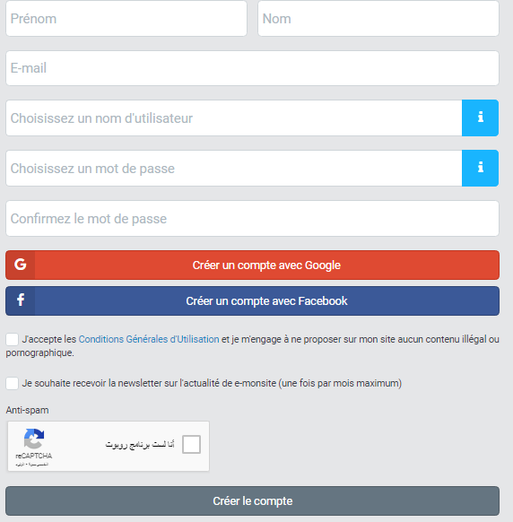
Subscription

Slide 4
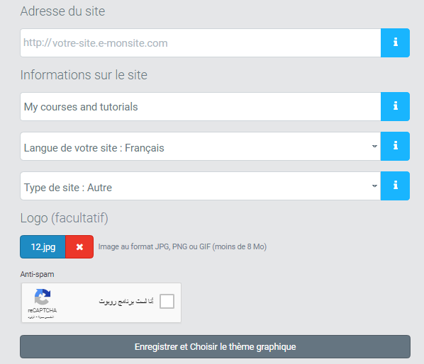
Setting the global information

Slide 5
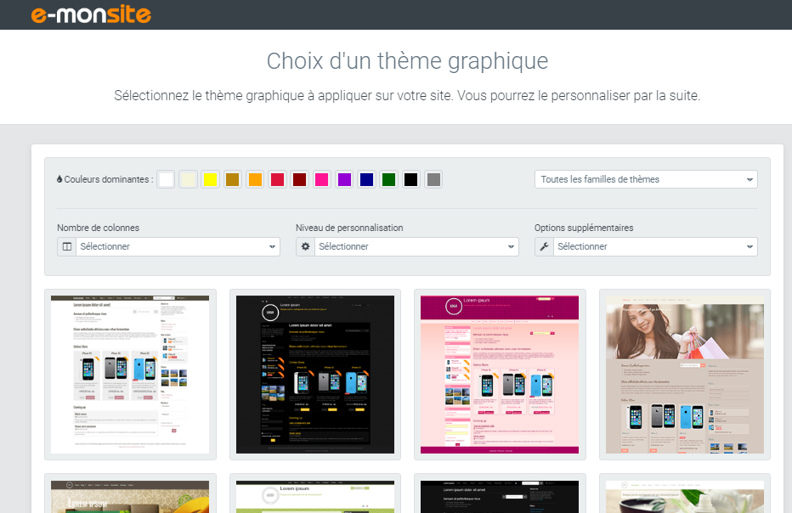
Choosing a design

Slide 6
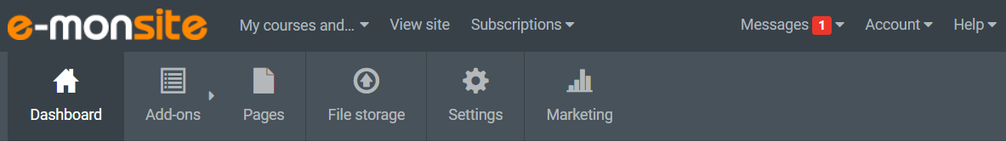
The website manager

Slide 7
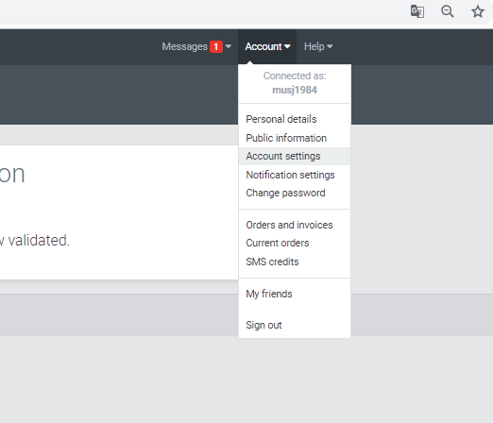
To change the language, time zone…
Account→ Account settings

Slide 8
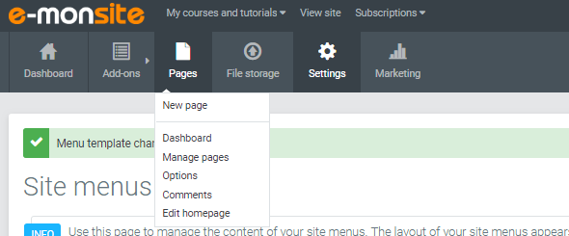
To create and edit categories and pages
Pages →Manage pages

Slide 9
To create a new page:
Select the category which will contain the new page
Click New page button
A category can contain pages and sub-categories

Slide 10
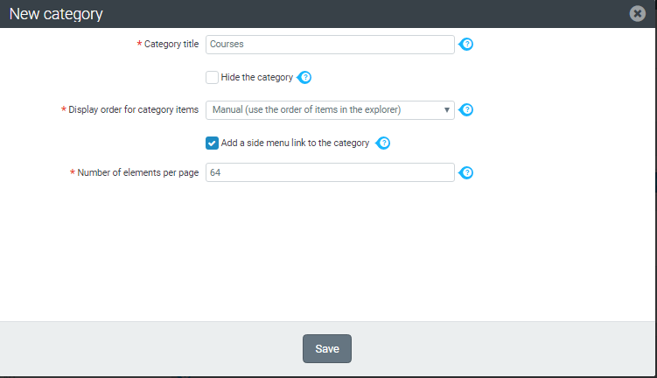
New category

Slide 11
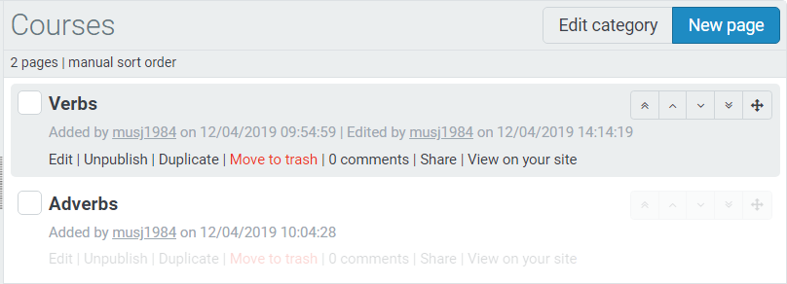
Pages and categories can be edited at any time using the following buttons.

Slide 12
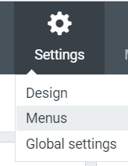
Managing side menus

Slide 13
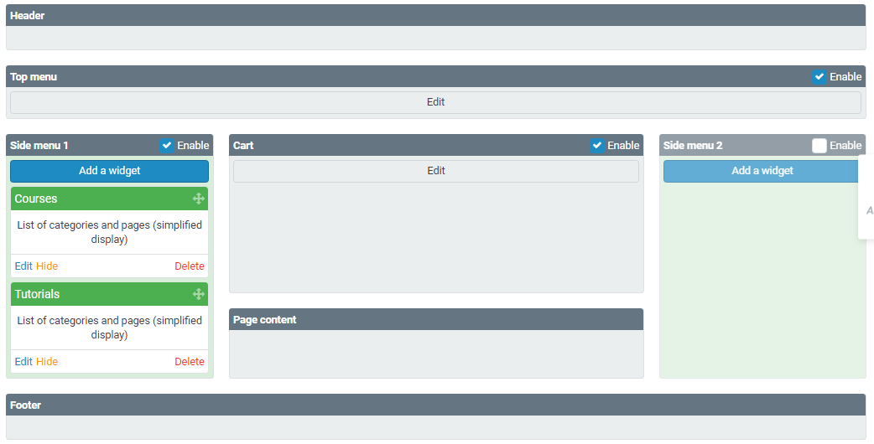

Slide 14
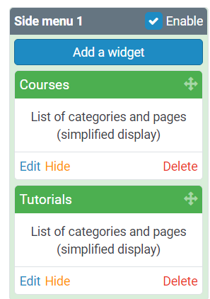
To add a new block in the side menu

Slide 15
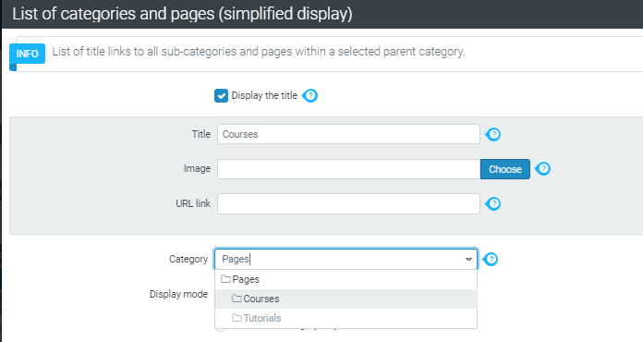
Assigning a category to a block(widget)

Slide 16
Managing the top menu

Slide 17
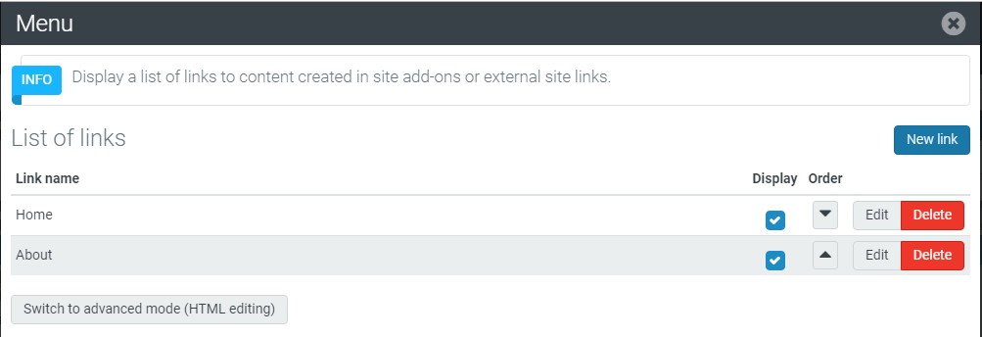
Adding a new link to the top menu

Slide 18
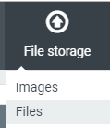
Adding a downloadable file
Step1:
Upload the file to file store using the menu file storage.

Slide 19
Step2:
Go to the page manager
Click the edit link of the page that you want to add the file to.
Browse to the end of the page
Click add block button
Choose downloadable file
Choose a file (the file must be uploaded before this step)

Slide 20
Inserting an image
Step1:
Upload the image to file store using the menu file storage.
Right click the image and click copy image address
(It will be used in the next step)

Slide 21

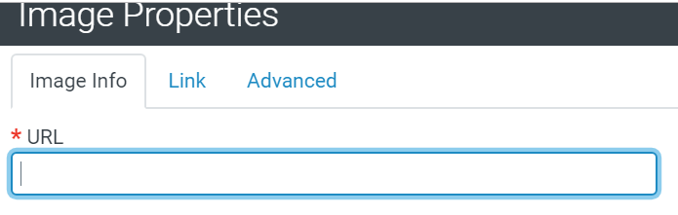
Step2:
Go to the page manager
Click the edit link of the page that you want to add the file to.
Click where you want to insert the image
Click the button
Paste the link that you have copied in step1 in the URL box

Slide 22
Best of luck

